Slide 1
motorBOAT training, testing and licensing
Presenter:
Title: Marlinespike
Manual – TAB 8
Date:

Slide 2
Better to know a knot and not need it, than need a knot and not know it

Slide 3
Marlinspike Seamanship
Objectives:
Understand What Marlinspike Seamanship is
Proper Way to Care for Line
Learn to tie the bowline, cleat wrap and clove hitch knots

Slide 4
Two ropes walk into a bar, one rope calls the bartender and says “Barkeep, let me get a couple of beers.” The bartender says “I’m sorry, we don’t serve ropes in here.”
Frustrated, the ropes walk out and since this was the only bar in town they thought about it until one rope says “I’ve got an idea!” So he gets himself into a bind and frizzles his ends and walks back into the bar and says “Barkeep, let me get a beer.”
The barkeep says “Aren’t you one of those ropes that came in earlier?”
The rope answers “No sir, I’m a frayed knot.”

Slide 5
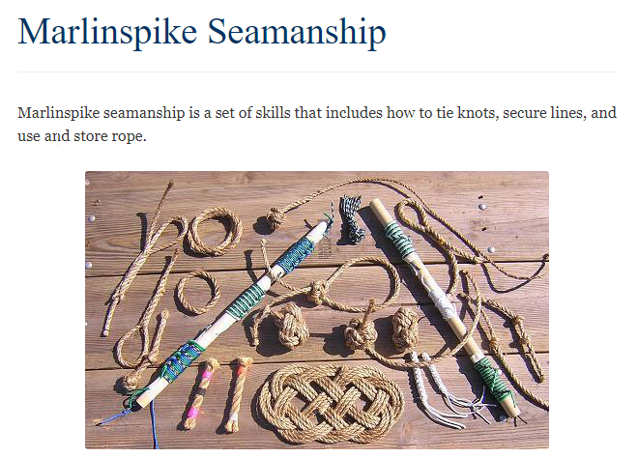
Marlinspike Seamanship

Slide 6
The name marlinespike is derived from the tool that is used for splicing. It can be a tapered metal pin or carved of wood.
Once a rope is onboard a boat and is given a specific purpose, such as dock line, halyard, etc. it is called a line, not a rope.

Slide 7
Common types of line
Natural Fibers (manila)- not great in salt water and shrinks when wet
Nylon - strongest line for its size, stretches up to 40%, can be stored wet
Polyester - not as strong and stretchy as nylon, may chaff
Polypropylene -floats, least costly, can cut skin , deteriorates in sunlight
Wire Rope - very strong, has little stretch, needs to be kept lubricated

Slide 8
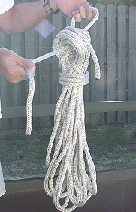
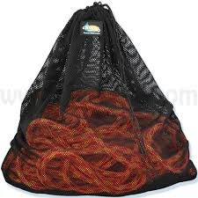
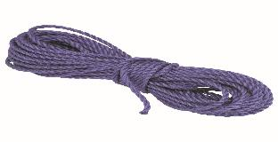
Line Care
Keep clean
Keep dry
Protect from abrasion
“Whip” ends to prevent unraveling

Slide 9
Knots to Know
Bowline - “King of knots”
Used to fasten your line to a object or just to make a loop in your line that will not slip.

Slide 10
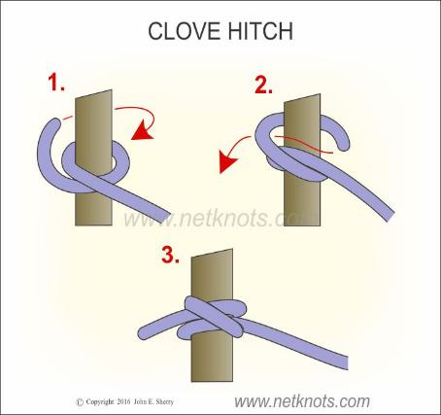
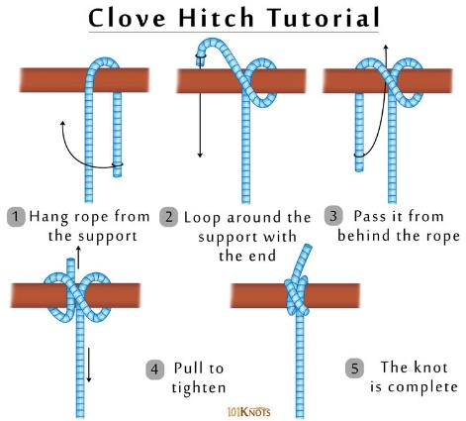
Clove Hitch - Used for quick, temporary post, spar or stake.

Slide 11
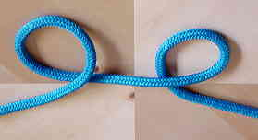
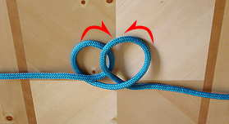
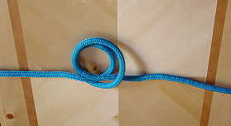
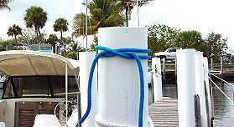
Clove Hitch
If you can reach the top of a piling or buoy, an alternative way to tie a clove hitch is to follow the illustrations below and then slip the loop over the piling or buoy and tighten.

Slide 12
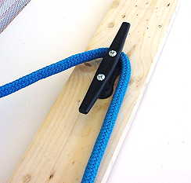
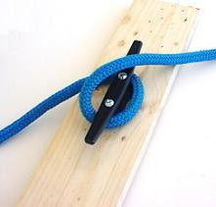
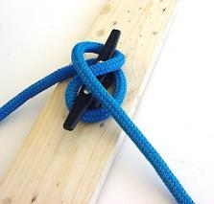
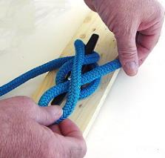
Cleat Wrap
Take the line to the ear of the cleat furthest from where the line comes from the load. Take one wrap around the base of the cleat and then figure eight across the top of the opposite ear. Finish with a half hitch turned under so that the line is coming away from the cleat in the opposite direction. More wrappings and hitches are not needed, as they only slow the process of casting off.

Slide 13
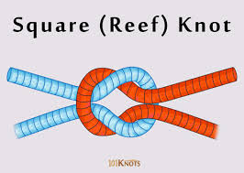
Knots of Interest
Square (or Reef) Knot
Used to tie together two lines of the same diameter
“Left over Right” “Right over Left”
Notes:
The reef knot, or square knot, is an ancient and simple binding knot used to secure a rope or line around an object. It is sometimes also referred to as a Hercules knot. The knot is formed by tying a left-handed overhand knot and then a right-handed overhand knot, or vice versa.
The Reef Knot or Square Knot is quick and easy to tie; it is a good knot for securing non-critical items. Not to be trusted to join two ropes together. This knot was used for centuries by sailors for reefing sails, hence the name Reef Knot, and tying things aboard ship.

Slide 14
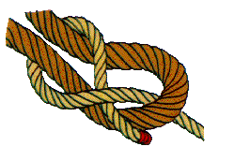
Knots of Interest
Sheet Bend (Weaver’s Knot)
Used to tie together two lines of different diameter
Notes:
The Sheet Bend or Weaver's Knot is recommended for joining two ropes of unequal size. The thicker rope must be used for the simple bight as shown. However, it works equally well if the ropes are of the same size.

Slide 15
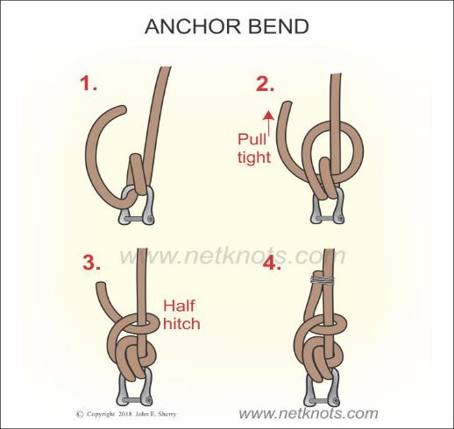
Knots of Interest
Anchor Bend
Used to secure a line to an anchor
Notes:
The Anchor Bend or Anchor Hitch is the knot generally used to fasten a line to an anchor. The free end should be secured with seizing to the standing line for a permanent, secure knot.
Also known by the names anchor bend and fisherman’s bend, this knot is basically used to connect an anchor line to an anchor. The nautical knot can also join a rope to a ring or similar termination. It is helpful when you need to set up a second anchor in a hurry. It doesn’t significantly reduce the line strength, is easy to tie and about 10% stronger than the bowline. The bend holds well even if you alternate the load between heavy and slack.

Slide 16
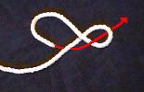
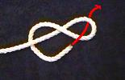
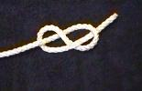
Knots of Interest
Figure Eight Knot
(Flemish Knot)
Used as a stopper
Notes:
The Figure 8 provides a quick and convenient stopper knot to prevent a line sliding out of sight, e.g., up inside the mast. Its virtue is that, even after it has been jammed tightly against a block, it doesn't bind; it can be undone easily. This virtue is also, occasionally, a vice. The figure 8 can fall undone and then has to be retied.

Slide 17
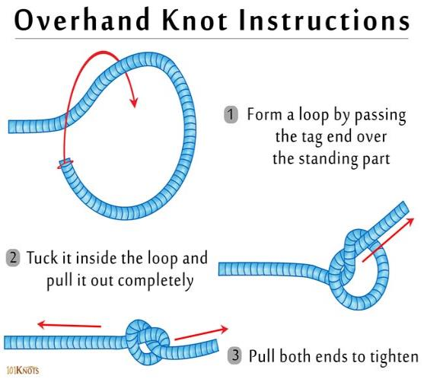
Knots of Interest
Overhand Knot
Use sparingly as it is difficult to untie after tightening
Notes:
The Figure 8 Knot is much better than the simple Overhand Knot, which is smaller and can bind so tightly that it can be really difficult to undo.

Slide 18
Knots of Interest
Two Half - Hitches
Used most often in mooring
Notes:
The two half-hitches is a type of knot, specifically a Binding Knot or Hitch Knot. It consists of an Overhand Knot tied around a post, followed by a half-hitch. Equivalently, it consists of a half-turn around a post followed by a Clove Hitch of the running end around the standing part.
This knot is also sometimes referred to as a clove hitch over itself, or double half-hitch.

Slide 19
References:
www.animatedknots.com
www.netknots.com
APPS for your smart phone
Our GOOGLE friend (or girlfriend, Alexa)
Notes:
“When you reach the end of your rope, tie a knot in it and hang on.”

